Slide 1



Hands-on: K-means Algorithm
Notes:
So now we have gathered an idea of what Data Visualization and Matplotlib is. Let us go ahead and see how to work with Matplotlib.

Slide 2
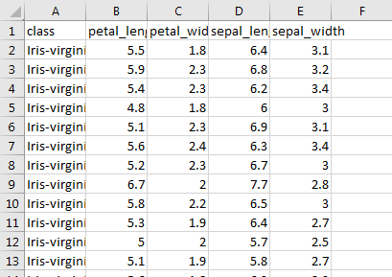
We will be using the famous Iris Dataset, collected in the 1930’s by Edgar Anderson.
In this example, we are going to train a random forest classification algorithm to predict the class in the test data
Demo-
K-means Algorithm

Slide 3

K-means Algorithm
Loading the famous Iris dataset:
1
Having a glance at the shape:
2
Notes:
Let us see how the operations on Pandas work. First we will see how to perform importing of any dataset. After that we will analyze data Then we’ll manipulate data.. At last we will perform data visualization.

Slide 4
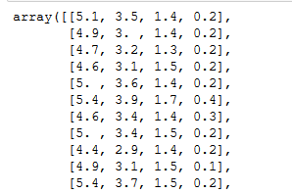
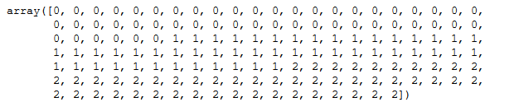
K-means Algorithm
Having a glance at the features
1
Having a glance at the targets
2
Notes:
Let us see how the operations on Pandas work. First we will see how to perform importing of any dataset. After that we will analyze data Then we’ll manipulate data.. At last we will perform data visualization.

Slide 5
K-means Algorithm
Building the model:
1
Set up the number of clusters:
2
Notes:
Let us see how the operations on Pandas work. First we will see how to perform importing of any dataset. After that we will analyze data Then we’ll manipulate data.. At last we will perform data visualization.

Slide 6
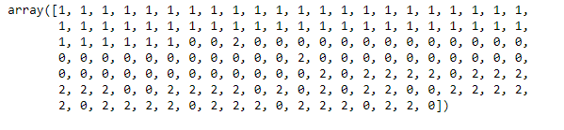

K-means Algorithm
Fit the features into the model:
1
Predict and label the data:
2
Having a look at the cluster centers:
3
Notes:
Let us see how the operations on Pandas work. First we will see how to perform importing of any dataset. After that we will analyze data Then we’ll manipulate data.. At last we will perform data visualization.

Slide 7

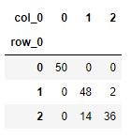
K-means Algorithm
Evaluating the Algorithm:
0's -> All 50 of them labeled as 0,
1's -> 48 of them labeled correctly, 2 of them labeled incorrectly
2's -> 36 of them labeled correctly, 14 of them labeled incorrectly
Notes:
Let us see how the operations on Pandas work. First we will see how to perform importing of any dataset. After that we will analyze data Then we’ll manipulate data.. At last we will perform data visualization.

